Slide 1
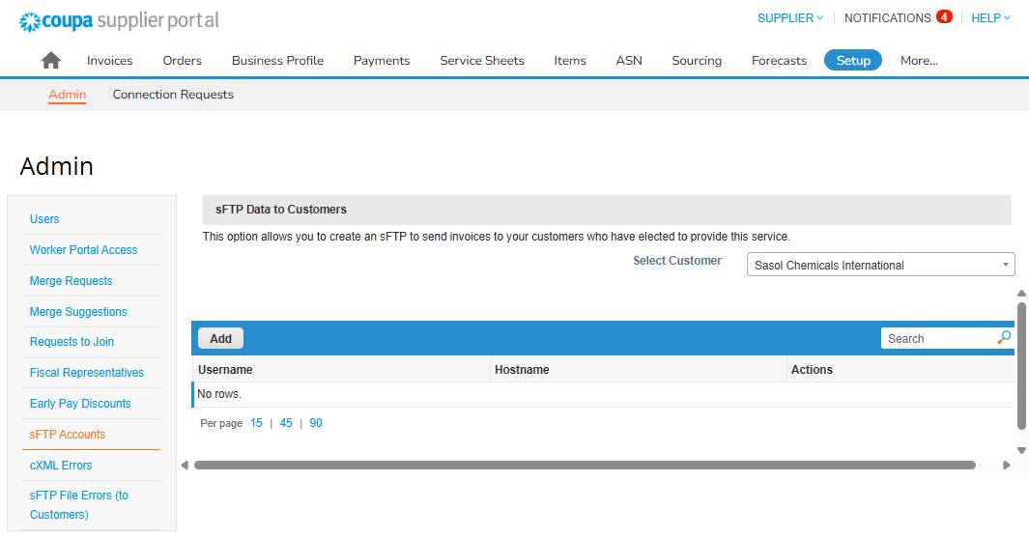
The aim of this document is to provide an overview of the creation process of your sFTP account in CSP to conduct business with Sasol. This document is only for Suppliers who will send the invoices to Sasol using an sFTP account.
Getting started
You will first need to log in to Coupa.
Click Setup.
Select the “sFTP Accounts” tab from the left side menu.
Choose the customer for which you will setup the sFTP account.
Click on “Add” to start creating the account.
1
4
3
2

Slide 2
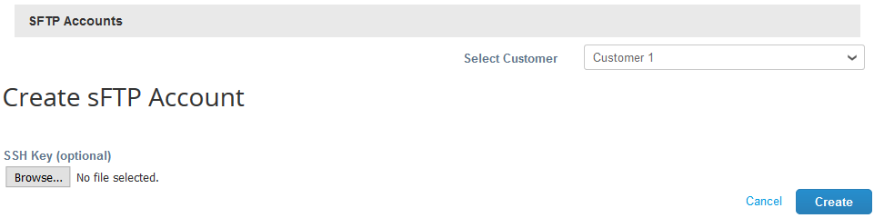
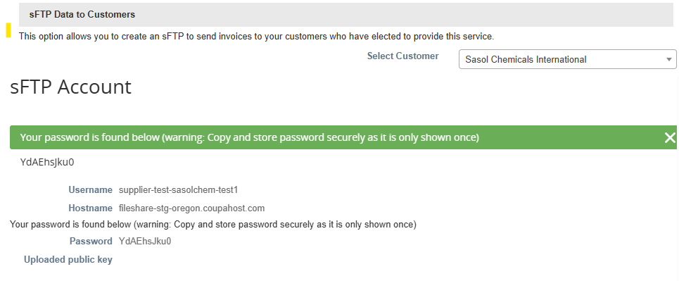

Account creation
Click on “Create”.
5
The “Username” and “Password” will become available.
6
Note:
Please make sure to store the Username and Password immediately because they will only be shown once.

Slide 3
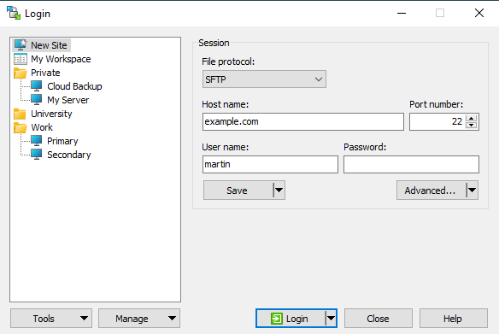
Once this one-time activity is done, you need to open any file transfer application (e.g.: WinSCP, FileZilla, etc.)
Enter the “Hostname”, “Username” and “Password”.
Click on “Login”
7
8
Once the connection is established, please follow the path below to reach the correct folder:
“Incoming” → "/Incoming/XInvoiceBuyer“ (for xInvoice format) OR "/Incoming/PeppolBISBuyer“ (for XML format with UBL encoding).
Once uploaded, Coupa will pick up the invoice files and create the user interface documents and match them against your orders.

