Slide 1

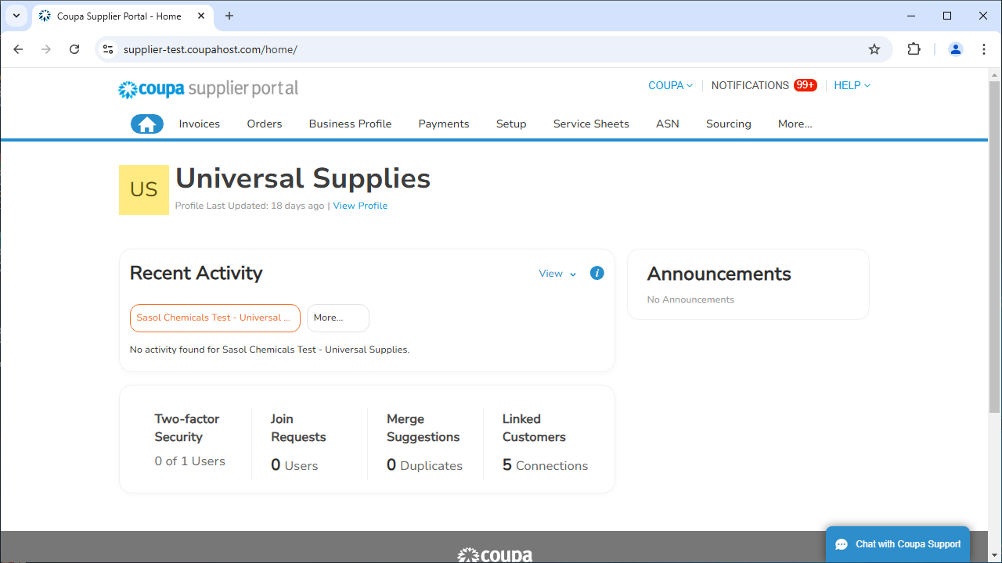
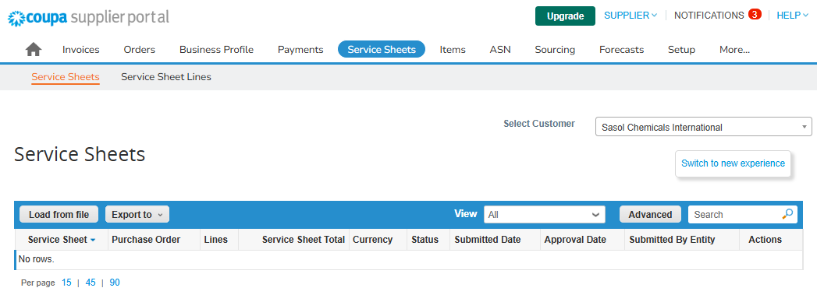
The aim of this document to provide an overview of the Service Entry Sheet Bulk Upload function in the Coupa Supplier Portal for both “Quantity” and “Amount” based Items. Suppliers can bulk-load multiple service sheets into Coupa at once, saving time and effort.
Note:
The data used in this Quick Reference Guide is for learning purposes only. Please use data that is specific to the transaction you are executing when working in the live system.
Log into CSP and Locate the Service Sheets Tab
Log into the CSP and click on the Service Sheets tab on the home screen.
Click on the “Load from file” button as shown below (classic Coupa experience).
1
2

Slide 2
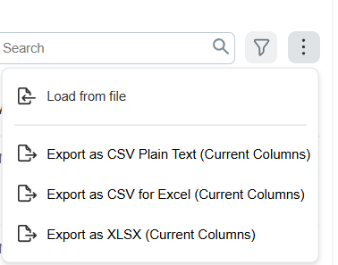
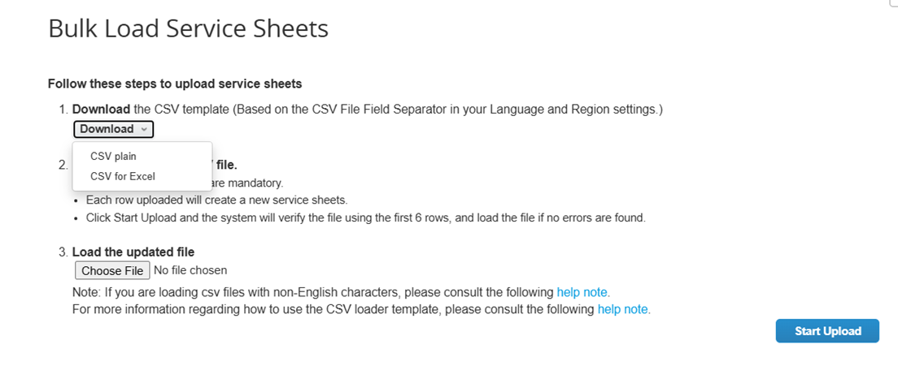
Do we need to tell people what that means? →
.
Download Bulk Upload Template
For the new Coupa experience, please follow the below steps:
Click on the three dots to open the menu.
Click on “Load from file”.
You will need to first download the Coupa specific template in the format suitable for you.
3a
3b
4
4

Slide 3
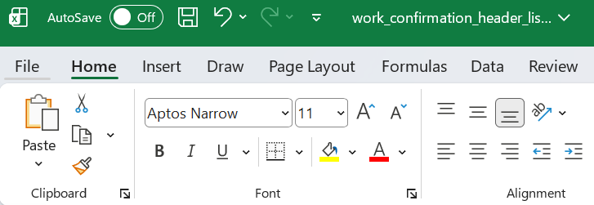
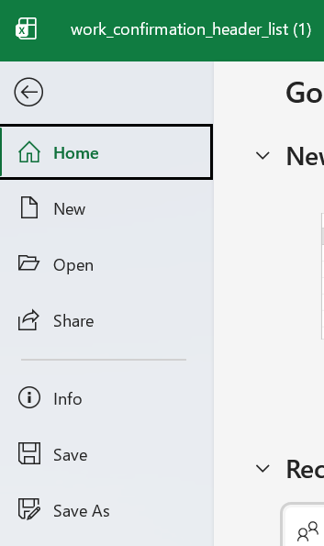
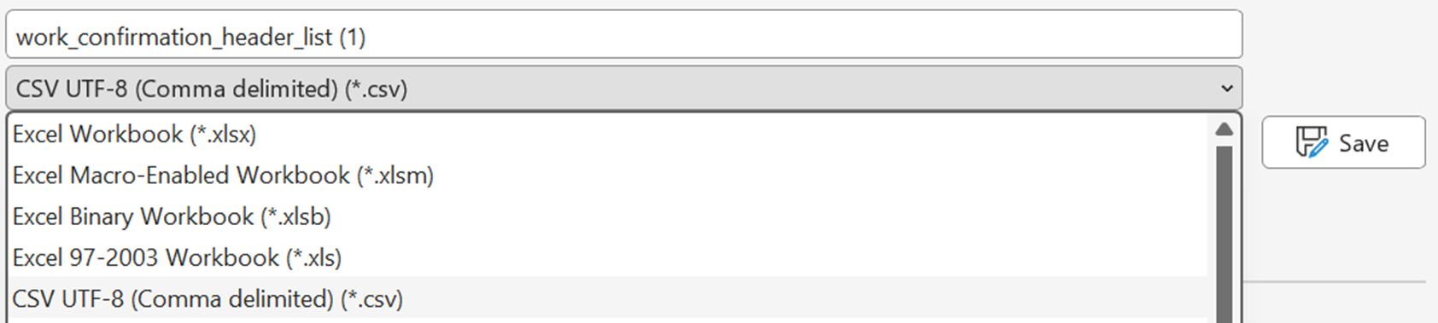
.
Convert Bulk Upload Template
5. Once you have downloaded the template, you can open it and convert it to the Coupa-acceptable format, as follows:
Go to “File” in the excel file;
Click on “Save as”;
Chose “CSV UTF-8 (Comma delimited) (*.csv) from the list
6. Once the above steps are completed, open the file to start entering the data.
5a
5c
5b
Repeated, but probably good that it is. →
Note:
The data used in this Quick Reference Guide is for learning purposes only. Please use data that is specific to the transaction you are executing when working in the live system.

Slide 4
.
Service Entry Sheet Field Descriptions
Row # | Row Description | Column | Field Input Value | Mandatory
1 | Service Sheet Header | B | PO Number | Yes
 |  | D | Supplier Name* (must match the supplier's name on the PO) | Yes
 |  | E | Supplier Number* (must match the supplier number in the supplier's profile)
 |  | F | External Reference
* Either Supplier Name or Supplier Number is required.
2 | Service Line | B | PO line Number | Yes
 |  | C | Completion Date
 |  | D | Budget Period
3 | Service Detail Line | B | PO Number | Yes
 |  | C | PO line Number | Yes
 |  | D | Service Description | Yes
 |  | E | Coupa Worker Assignment Id
 |  | F | External Worker Assignment Reference
 |  | G | Rate Name
 |  | H | Price
 |  | I | Quantity | Yes
 |  | J | UOM
 |  | K | Week Start Date
 |  | L - R | Day 1 – 7 Hours
Service Detail Line Row Comments: Columns E and F: To specify a Worker Assignment, enter either a valid Coupa Worker Assignment # (in column E) or an External Worker Assignment Reference (in column F). Column I: Quantity is required if a quantity-based rate is specified. For resource-based order lines, quantities are entered in columns L through R. Column K (week start date) is required. Columns H and J: Price and UoM are required if you do not specify a rate that was assigned to the PO line in column G.
Do we need to tell people what that means?
←
Do we need to tell people what that means?
←

Slide 5
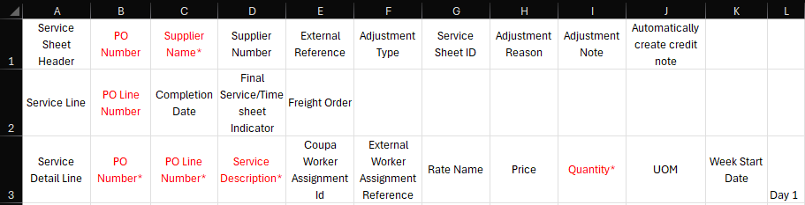
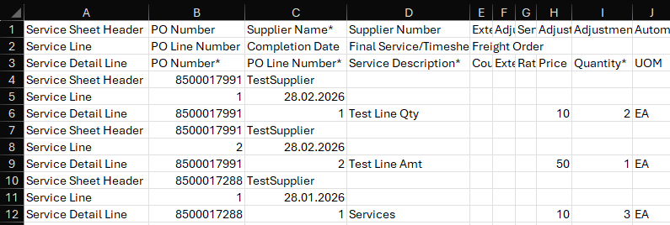
Service Entry Sheet Template
Please find below the template previously described in slide 4. Fields in red are mandatory.
Further, you have an example of a template filled in for 2 Orders (one with two line items and one with a single line item) using the bulk upload functionality.
For each PO you must fill in the next rows using the same header template, completing only the necessary information. The same rule applies if a PO has multiple line items.
To ensure the template is properly filled in, we have color-coded the fields based on the Header Rows:
Service Sheet Header Fields – marked in green
Service Line Fields – marked in purple
Service Detail Line Fields – marked in blue
For each additional line item that you would like to add to the template, the section in yellow must be copied.

Slide 6
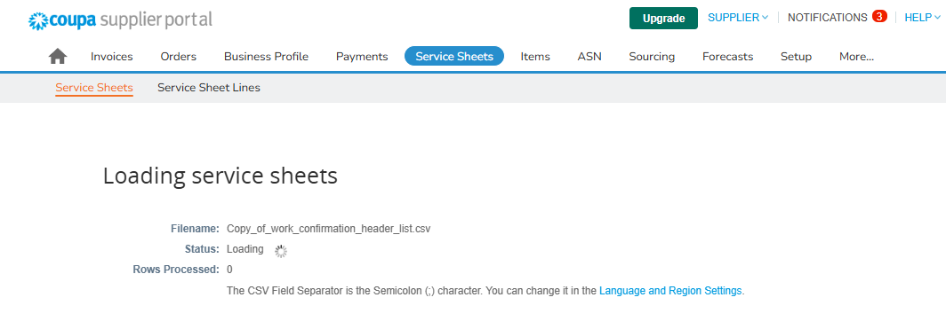
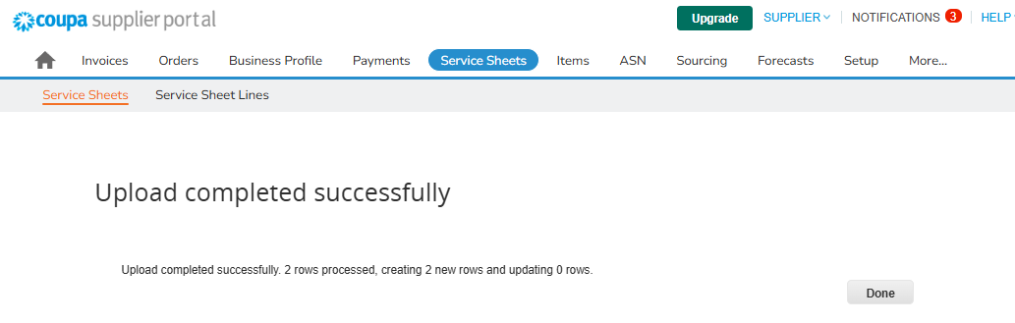
Service Entry Sheet Template Upload
Once you have finalized the template and saved it, you can proceed to upload it by clicking “Choose file”, selecting your file and clicking on “Start Upload”.
7
Coupa will show you the progress on the lines you have uploaded.
Once Coupa finishes the upload, you will receive the message below and you can click on “Done”.
9

Slide 7
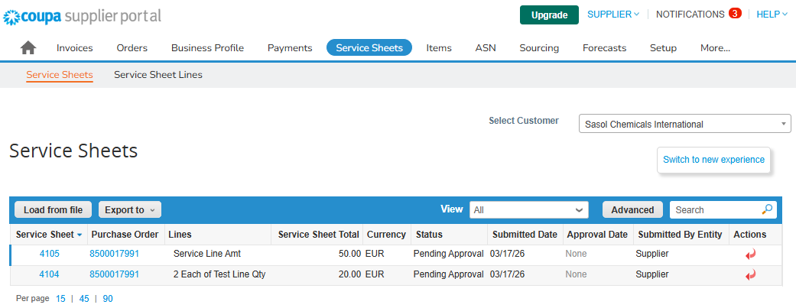
The successful Service Entry Sheets will be available in the “Service Sheets” section of your profile.
This one seems to make little sense – remove the columns of columns? →
Best practices:
Remove the columns of any non-required columns that you're not updating. Only include required fields and the ones you want to change. Removing extra columns helps ensure you won't make accidental changes and speeds up the process.
Check your CSV template files after each major Coupa update. Sometimes Coupa changes or adds new required fields to support new features.

